Slide 1

NITHISH R Final Project

Slide 2
Real-Time Traffic Accident Prediction and Prevention using Multi-Source Data Fusion

Slide 3
Agenda
Problem statement
Project overview
Who the end users are?
Your solutions and its value propositions
The won in your solution
Results

Slide 4
Problem statement
In order to improve the prediction accuracy, this paper proposes a traffic accident risk prediction method of tunnel based on multi-source heterogeneous data fusion. Firstly, the feature extraction and coding model based on Gabor cloud image is constructed, and the unstructured cloud image is enhanced by amplitude feature level and then encoded by fusion. Secondly, the long sequence formed after the sample concatenation of the multi-source heterogeneous data of tunnel is used as the input of the prediction model GRU (Gate Recurrent Unit), and AdaBoost (Adaptive Boosting) is introduced to learn the prediction results to further improve the robustness of the prediction model. The experimental results show that the proposed GRU-AdaBoost model achieves the prediction accuracy of 84.59% when the data volume is 3 years and the time interval is 5 weeks. When the data volume is 1 year and the time interval is 3 weeks, the prediction accuracy can reach 80.85%, which is 9.61% higher than traditional prediction model

Slide 5
Project overview
To solve existing problems, this paper proposes a tunnel traffic accident risk prediction method based on multi-source heterogeneous data fusion. The entire tunnel traffic accident risk prediction system can be divided into three parts: data preprocessing, optimization training of prediction models, and output of model training verification. The data preprocessing includes feature extraction and encoding of unstructured data cloud images, and model optimization training introduces the AdaBoost algorithm to optimize the model based on the GRU network.

Slide 6
Who the end users are?
Recently, development in intelligent transportation systems (ITS) requires the input of various kinds of data in real-time and from multiple sources, which imposes additional research and application challenges. Ongoing studies on Data Fusion (DF) have produced significant improvement in ITS and manifested an enormous impact on its growth. This paper reviews the implementation of DF methods in ITS to facilitate traffic flow analysis (TFA) and solutions that entail the prediction of various traffic variables such as driving behavior, travel time, speed, density, incident, and traffic flow. It attempts to identify and discuss real-time and multi-sensor data sources that are used for various traffic domains, including road/highway management, traffic states estimation, and traffic controller optimization. Moreover, it attempts to associate abstractions of data level fusion, feature level fusion, and decision level fusion on DF methods to better understand the role of DF in TFA and ITS. Consequently, the main objective of this paper is to review DF methods used for real-time and multi-sensor (heterogeneous) TFA studies. The review outcomes are (i) a guideline of constructing DF methods which involve preprocessing, filtering, decision, and evaluation as core steps, (ii) a description of the recent DF algorithms or methods that adopt real-time and multi-sensor sources data and the impact of these data sources on the improvement of TFA, (iii) an examination of the testing and evaluation methodologies and the popular datasets and (iv) an identification of several research gaps, some current challenges, and new research trends.

Slide 7
Your solution and its value proposition
Gabor filter can effectively extract local texture features at spatial scale, and its essence is to use Gaussian function as window function for short-time Fourier transform [26]. In this paper, through the analysis of the cloud graph features, the Gabor filter with multi-directional and multi-scale feature extraction ability is taken as the cloud graph feature extraction algorithm. The specific design is: (1) direction parameter adjustment. By setting different direction parameters, the texture trend characteristics and edge information of cloud layer in different directions are extracted. (2) Adjustment of scale parameters. By setting different scale parameters, the key local features of different scales of clouds are extracted. The complex form of the two-dimensional Gabor filter kernel function is shown in Equations 3-1 and 3-2. G(x,y)k=∥k¯∥2σ2exp(−∥k¯∥2(x2+y2)σ2)⋅[exp(ik(xy))−exp(−σ22)]=(kvkvcosφμsinφμ)(3-1)(3-2)

Slide 8
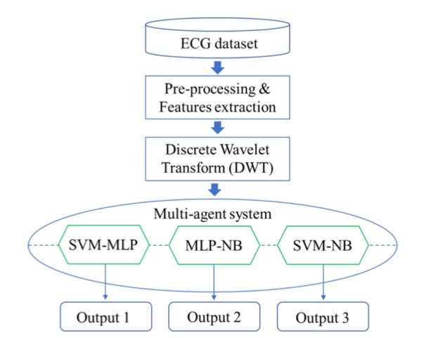
The wow in your solution

Slide 9
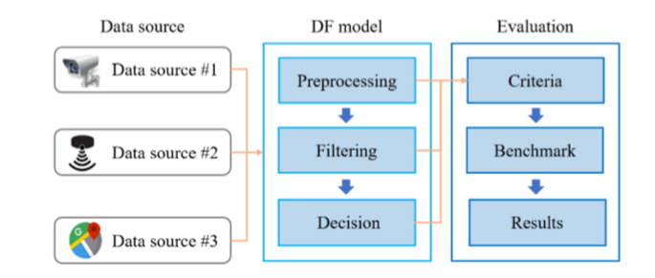
Modelling

Slide 10
Results
Considering the low accuracy of traditional neural network models in accident prediction, this paper improves the GRU AdaBoost model to predict the risk of traffic accidents in highway tunnel. In response to the low accuracy of a single data and the tendency for overfitting when there are multiple data types, Gabor filters are adopted to extract and fuse data features, and the fused data were used as input to the GRU AdaBoost model. The simulation results show that the improved GRU AdaBoost network model has an accuracy of 84.59% when the data volume is three years and the time interval is five weeks. When the data volume is one year and the time interval is three weeks, the prediction accuracy can reach 80.85%, which is 9.61% higher than the traditional prediction model GRU and BPNN AdaBoost. This effectively overcomes the defect of low accuracy of the GRU model when the data time interval is long, improves the prediction accuracy of the model, and alleviates the overfitting phenomenon that occurs when there is less data.

